Slide 1


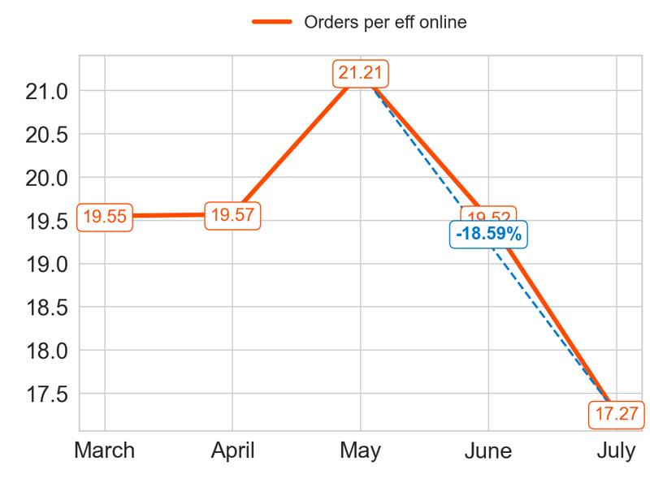
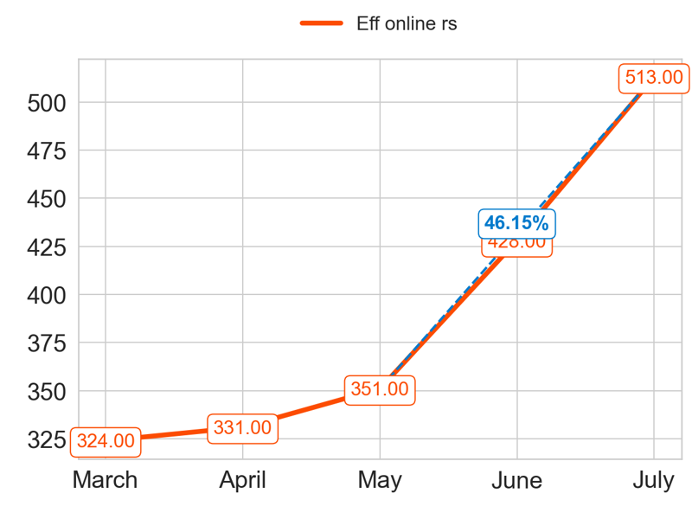
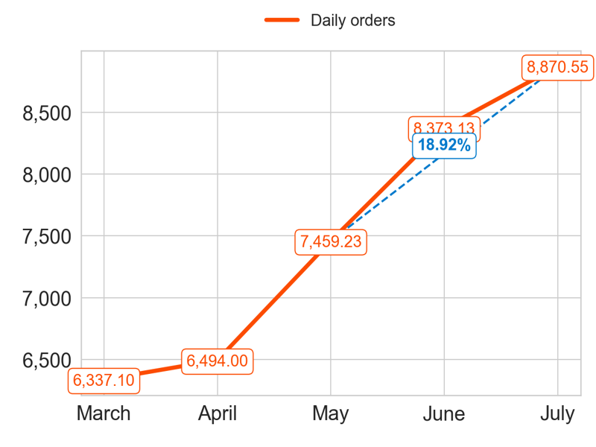
PERFORMANCE
Action Title
Priority 1 -
Insights
Mean over the last 4 months: 19.39
Mean over the last 4 months: 405.75
Mean over the last 4 months: 7799.23

Slide 2
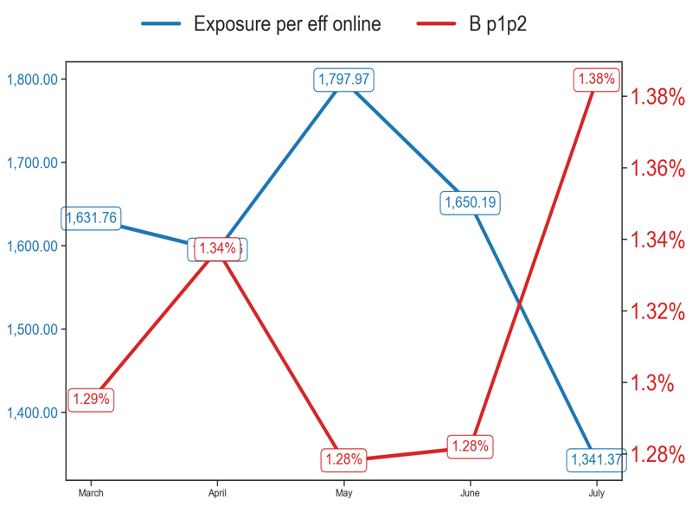
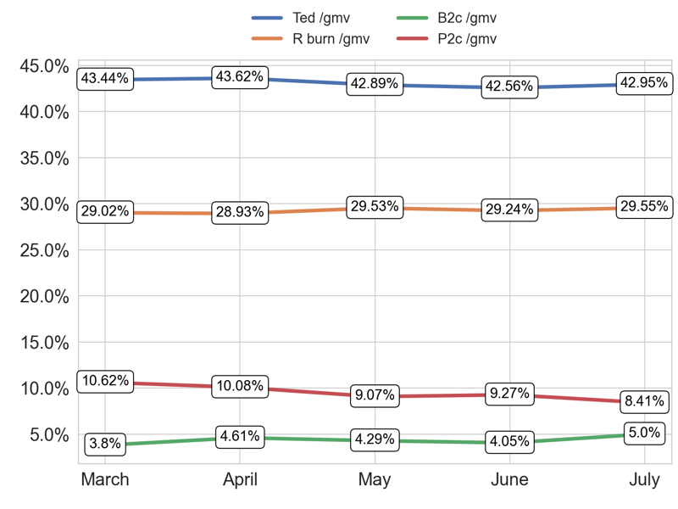
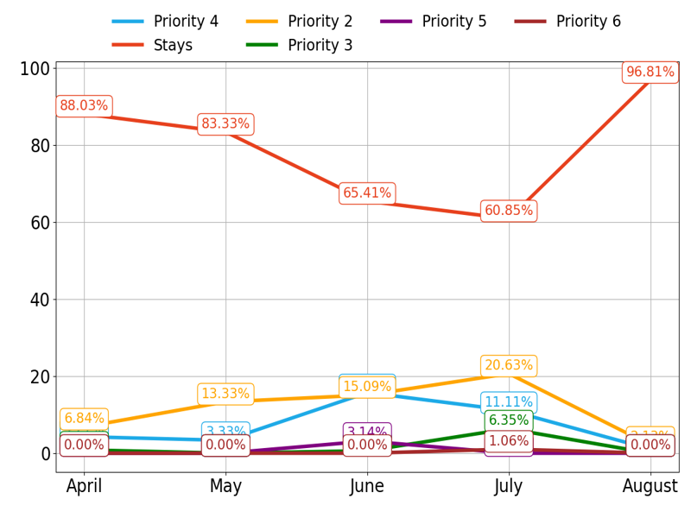
MIXED
Action Title
Priority 1 -
Insights
Example text
Example text
Example text

Slide 3
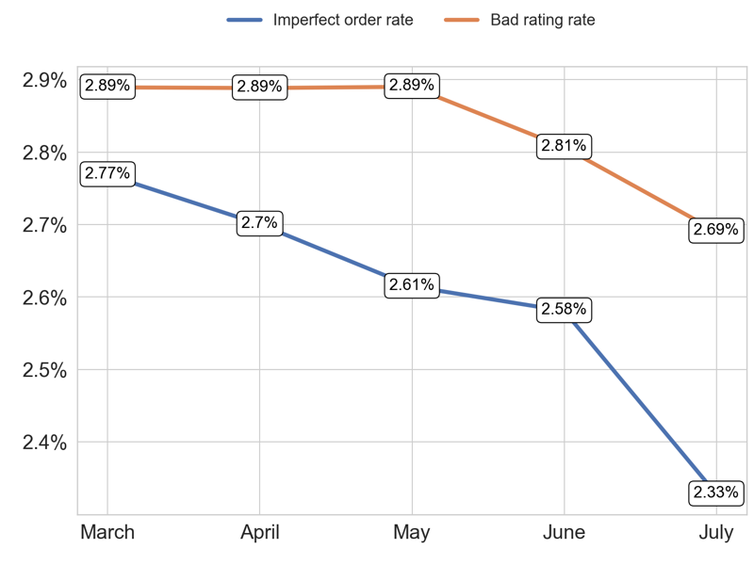
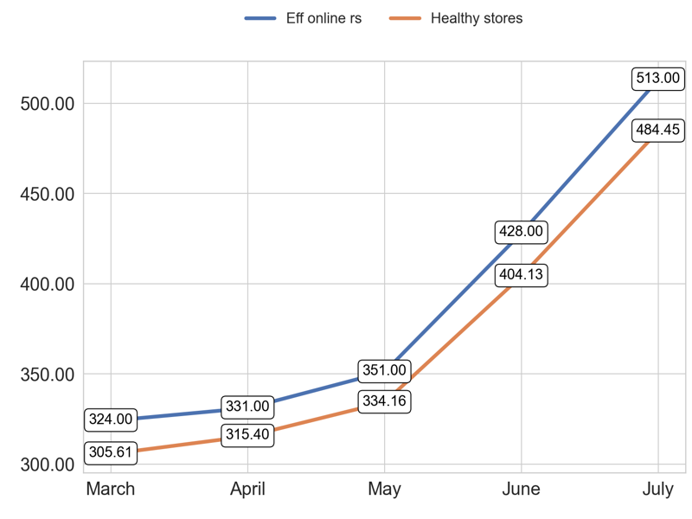
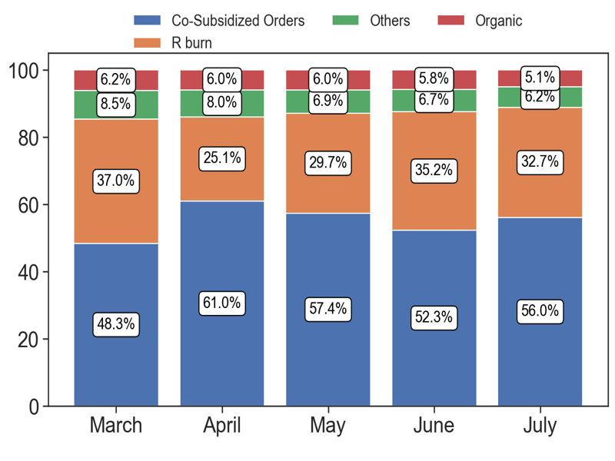
SERVICE
Action Title
Priority 1 -
Insights
Example text
Example text
Example text

Slide 4
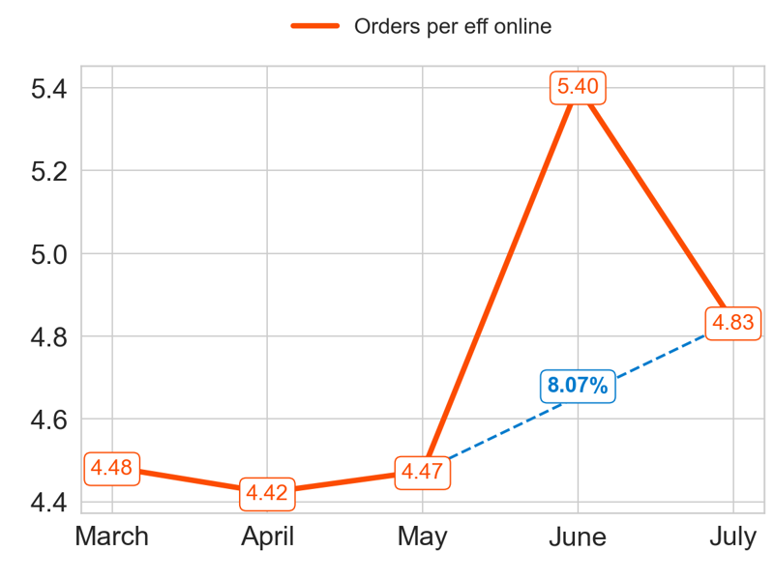
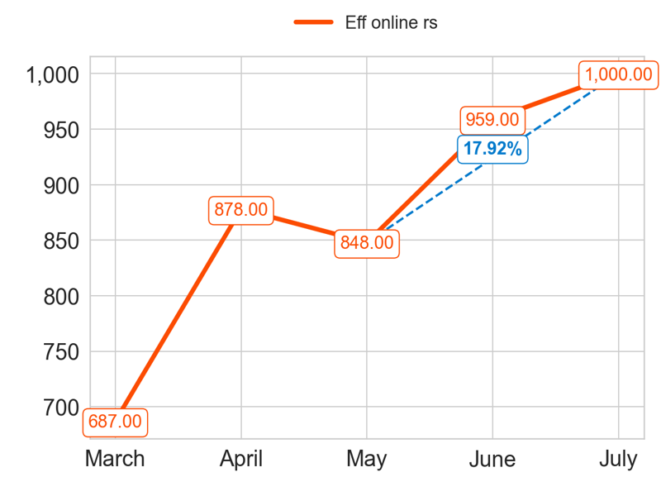
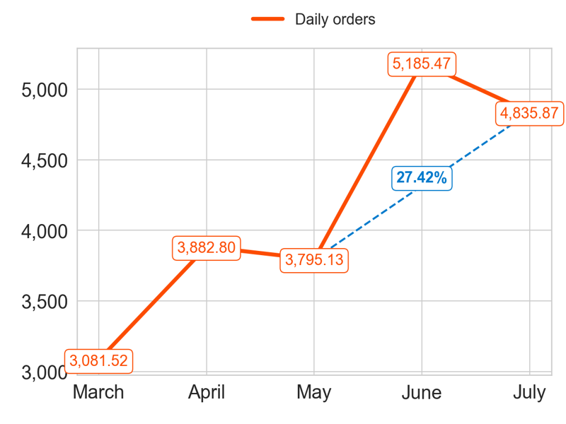
PERFORMANCE
Action Title
Priority 2 -
Insights
Mean over the last 4 months: 4.78
Mean over the last 4 months: 921.25
Mean over the last 4 months: 4424.82

Slide 5
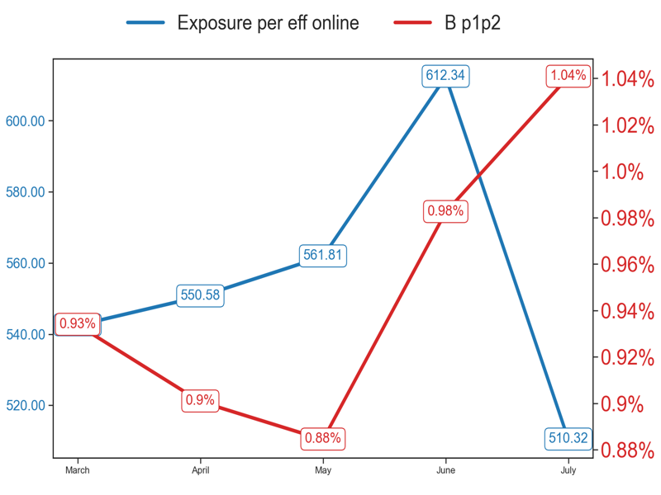
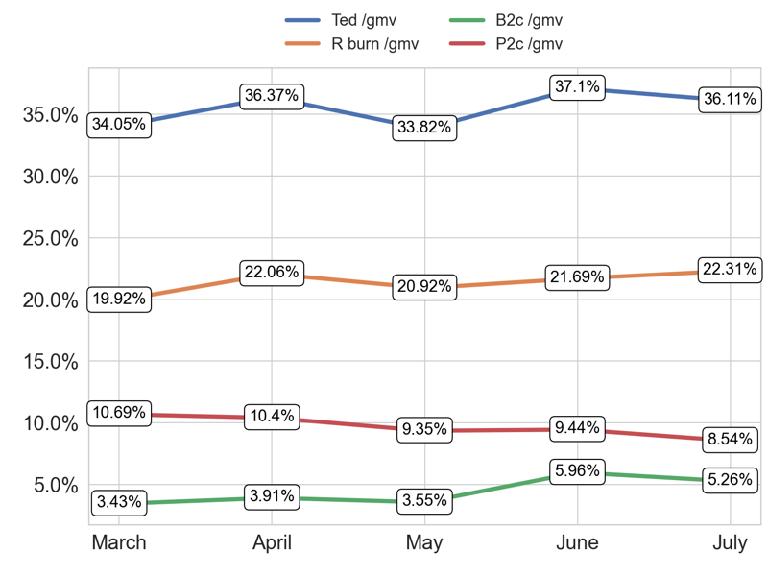
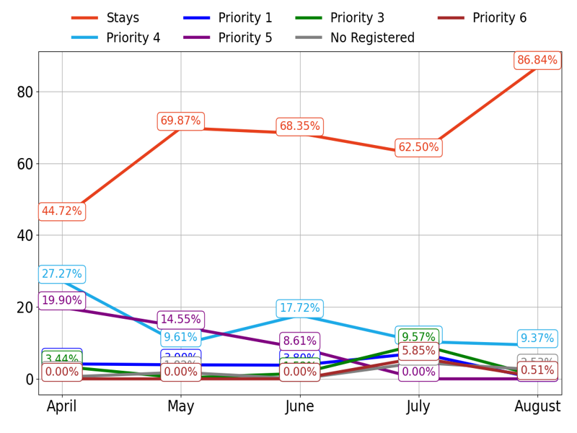
MIXED
Action Title
Priority 2 -
Insights
Example text
Example text
Example text

Slide 6
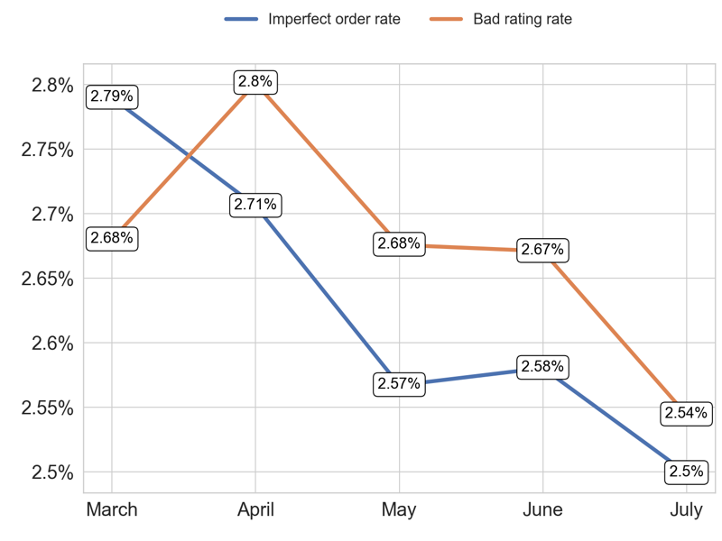
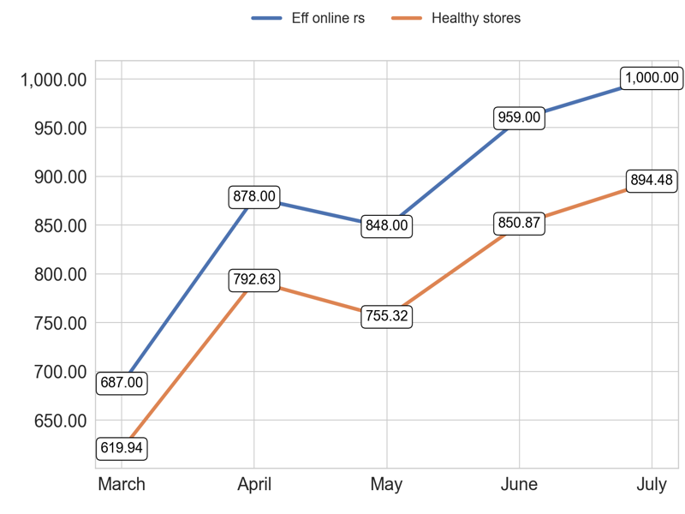
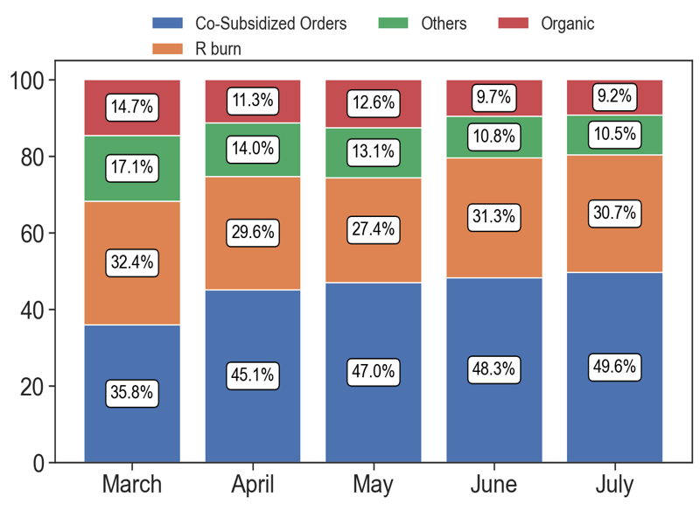
SERVICE
Action Title
Priority 2 -
Insights
Example text
Example text
Example text

Slide 7
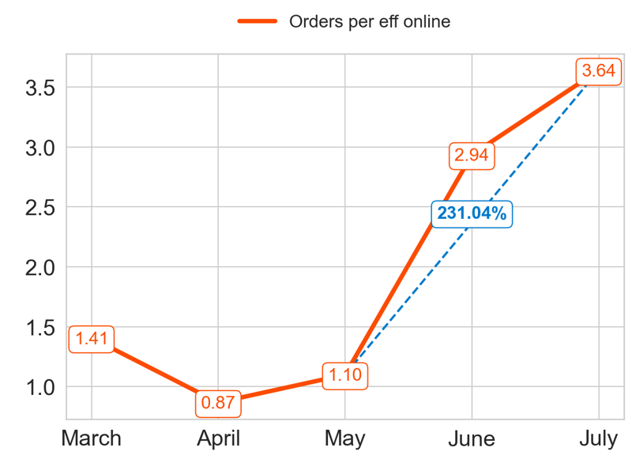
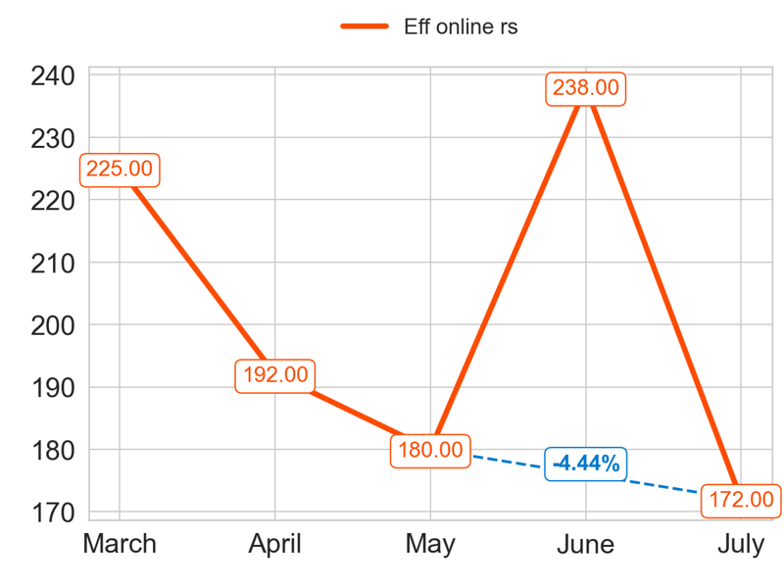
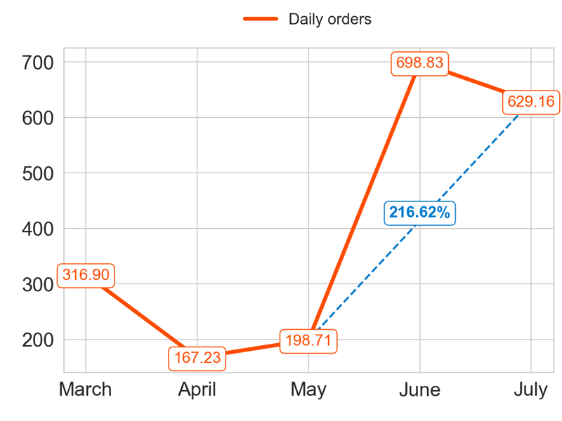
PERFORMANCE
Action Title
Priority 3 -
Insights
Mean over the last 4 months: 2.14
Mean over the last 4 months: 195.5
Mean over the last 4 months: 423.48

Slide 8
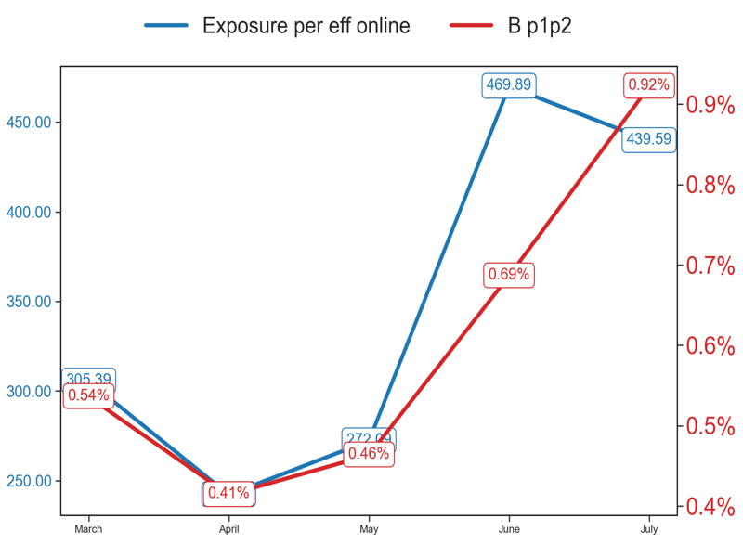
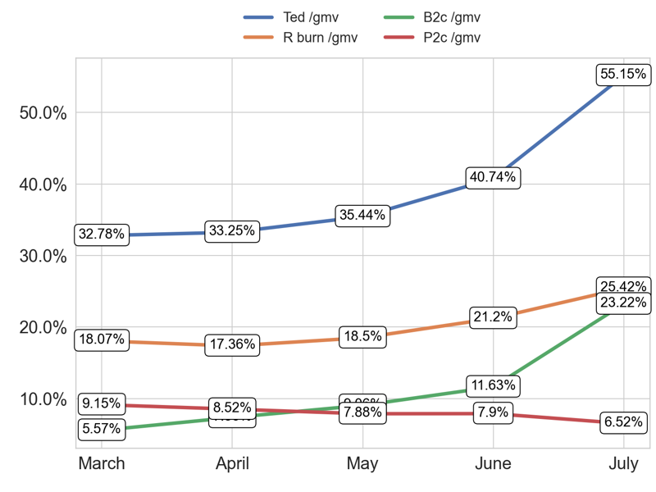
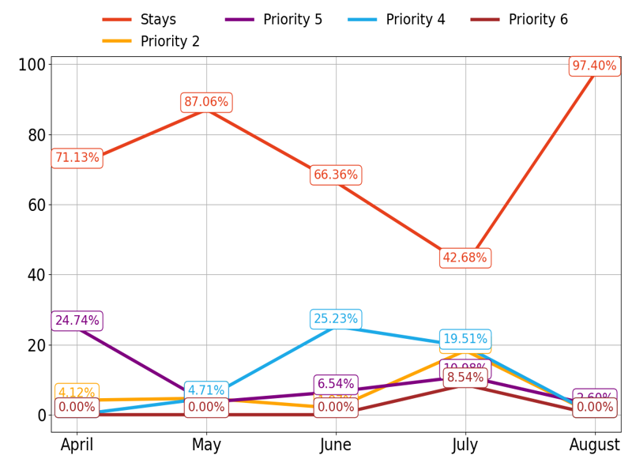
MIXED
Action Title
Priority 3 -
Insights
Example text
Example text
Example text

Slide 9
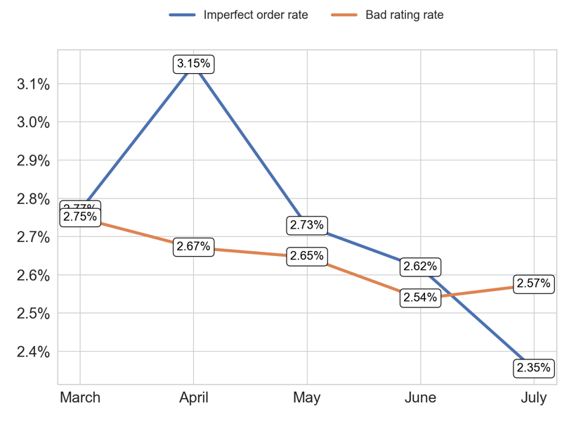
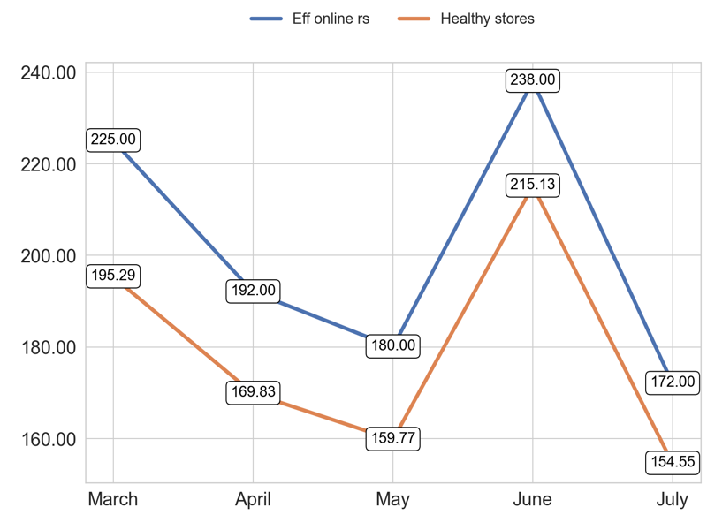
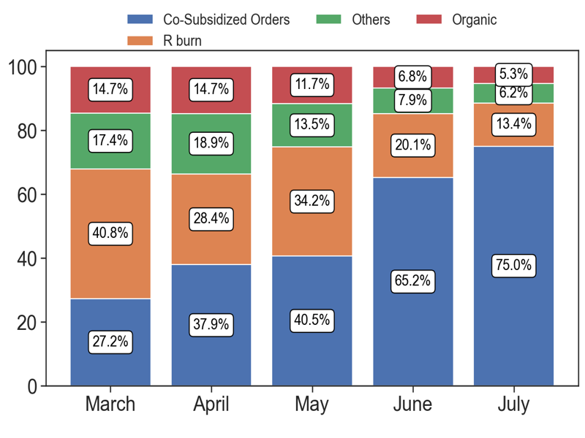
SERVICE
Action Title
Priority 3 -
Insights
Example text
Example text
Example text

Slide 10
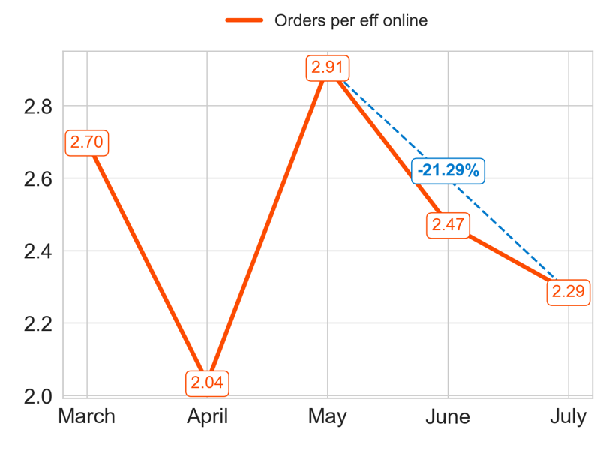
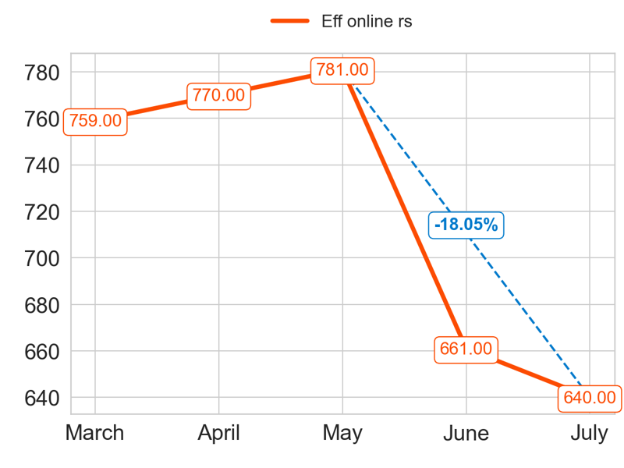
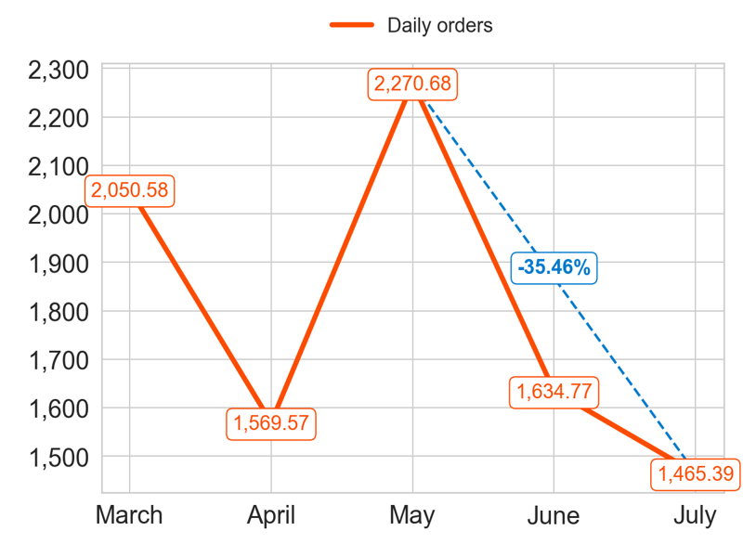
PERFORMANCE
Action Title
Priority 4 -
Insights
Mean over the last 4 months: 2.43
Mean over the last 4 months: 713.0
Mean over the last 4 months: 1735.1

Slide 11
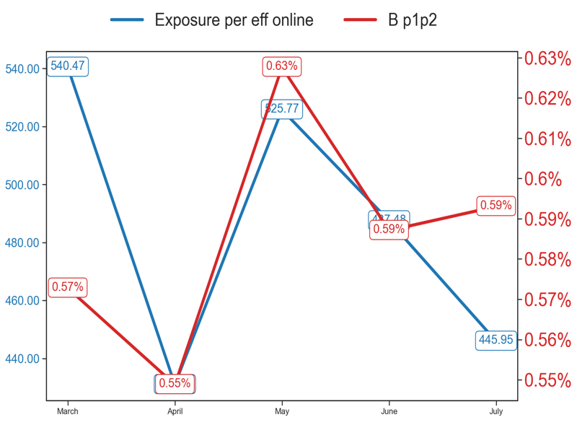
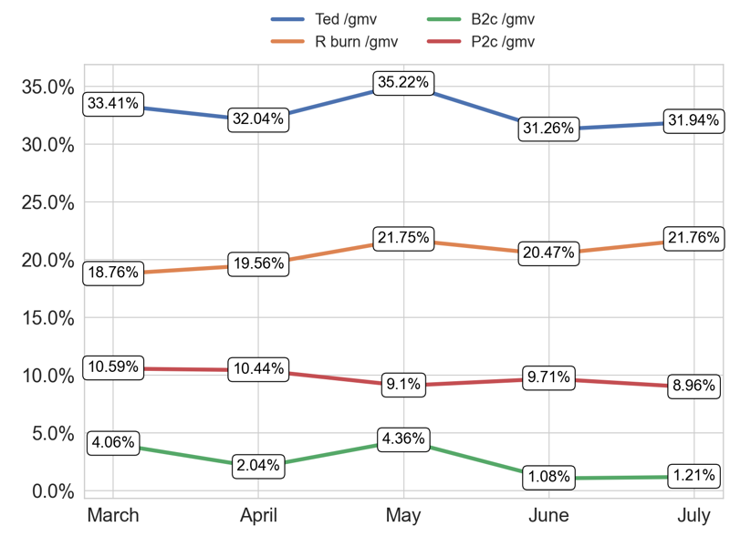
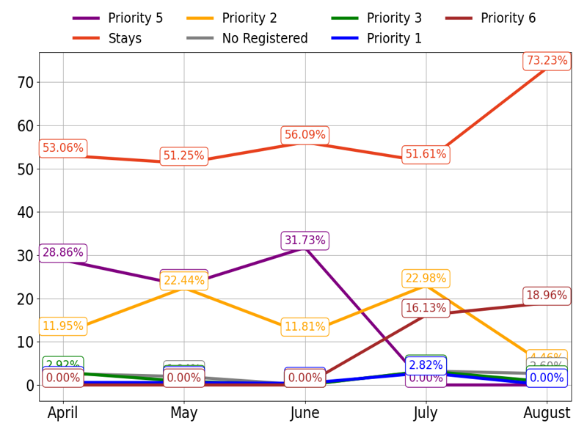
MIXED
Action Title
Priority 4 -
Insights
Example text
Example text
Example text

Slide 12
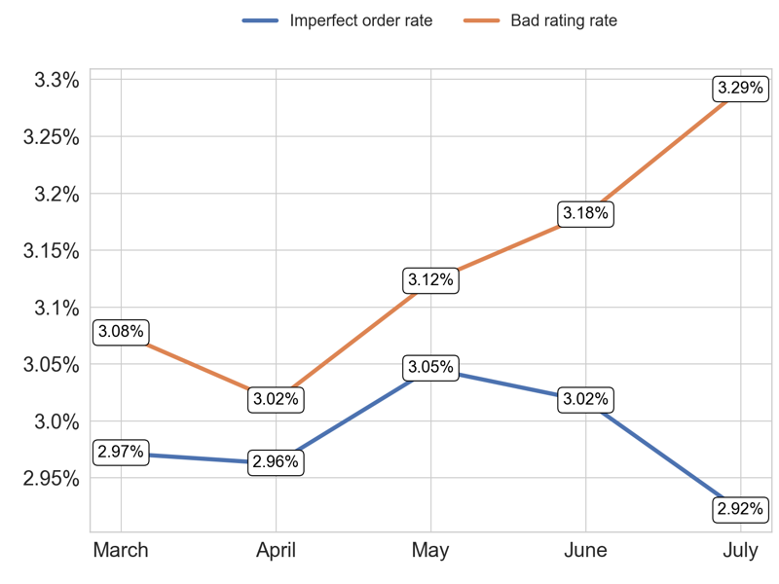
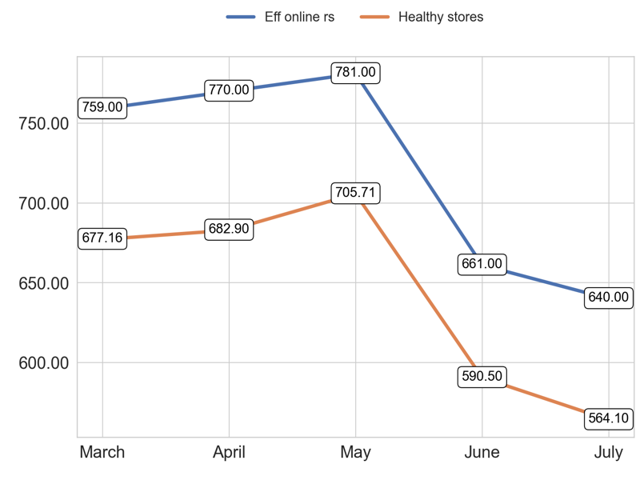
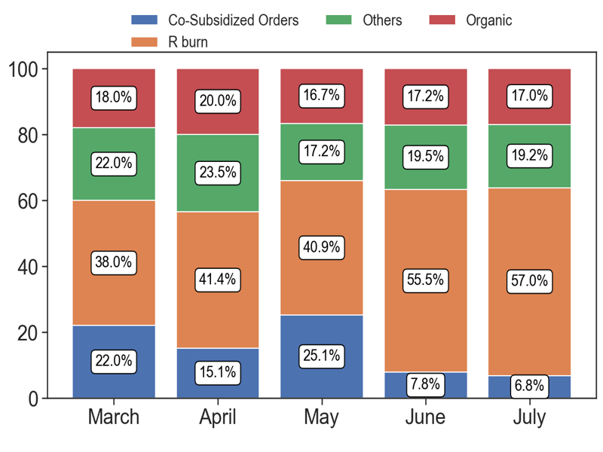
SERVICE
Action Title
Priority 4 -
Insights
Example text
Example text
Example text

Slide 13
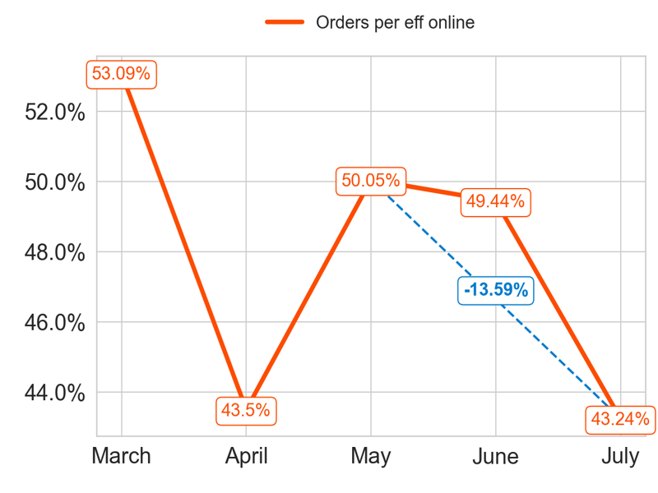
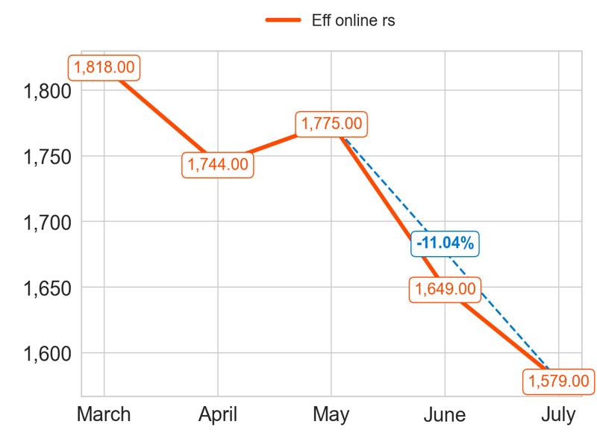
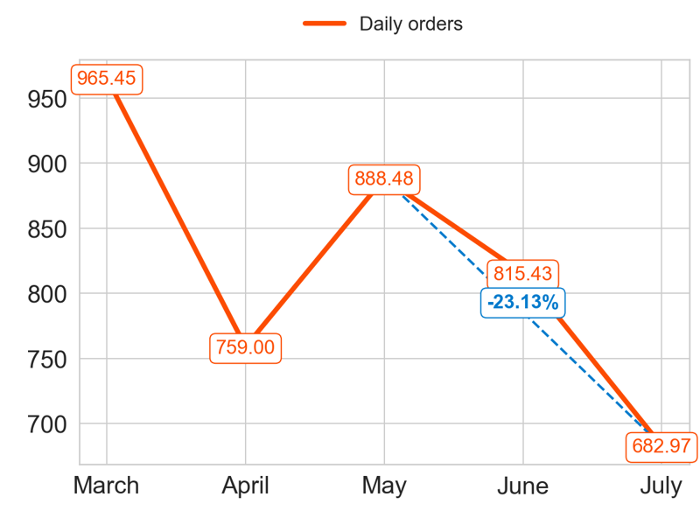
PERFORMANCE
Action Title
Priority 5 -
Insights
Mean over the last 4 months: 0.47
Mean over the last 4 months: 1686.75
Mean over the last 4 months: 786.47

Slide 14
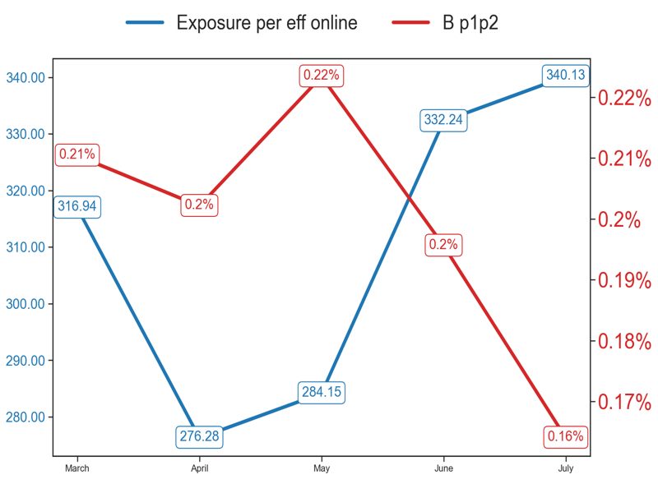
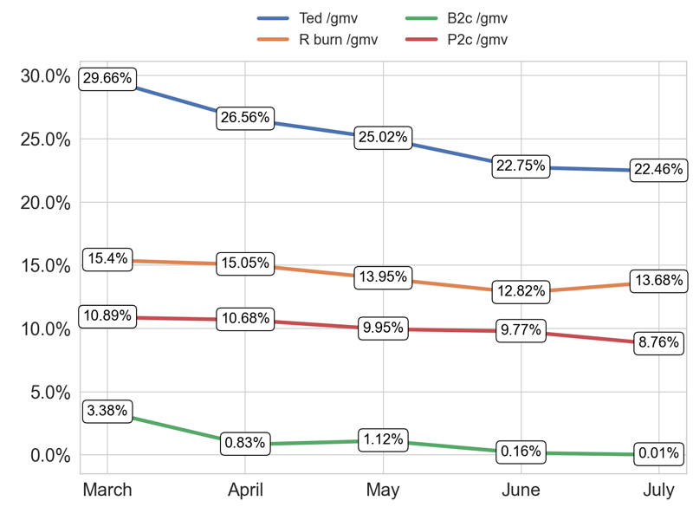
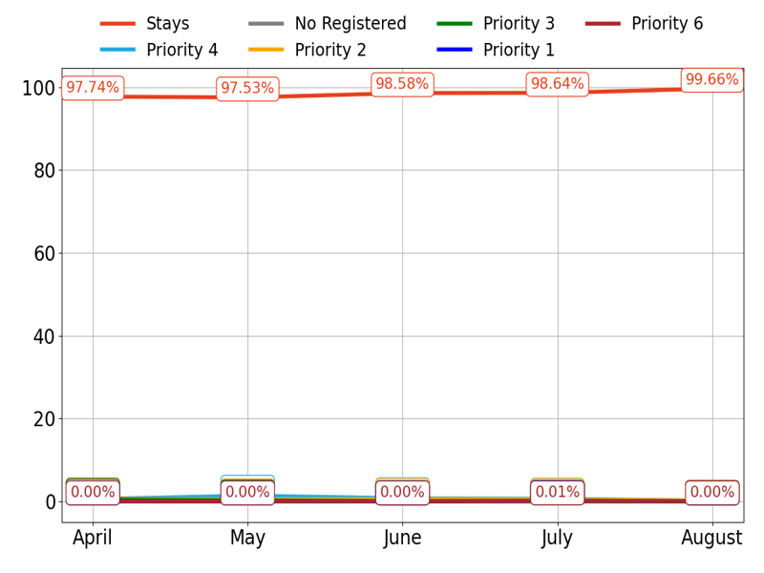
MIXED
Action Title
Priority 5 -
Insights
Example text
Example text
Example text

Slide 15
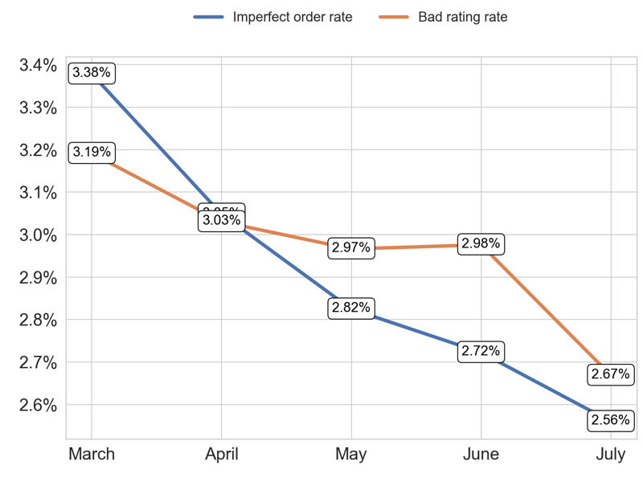
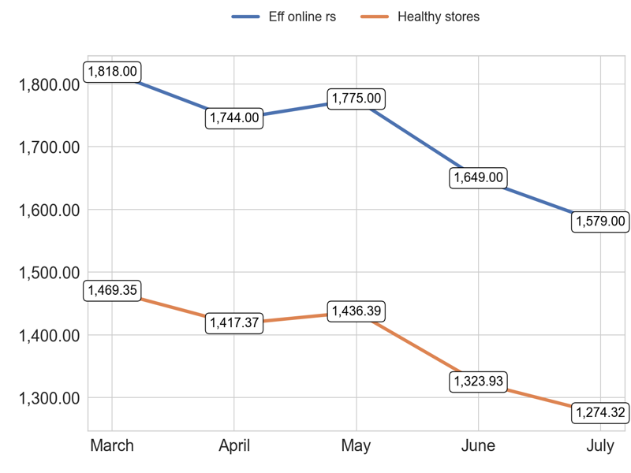
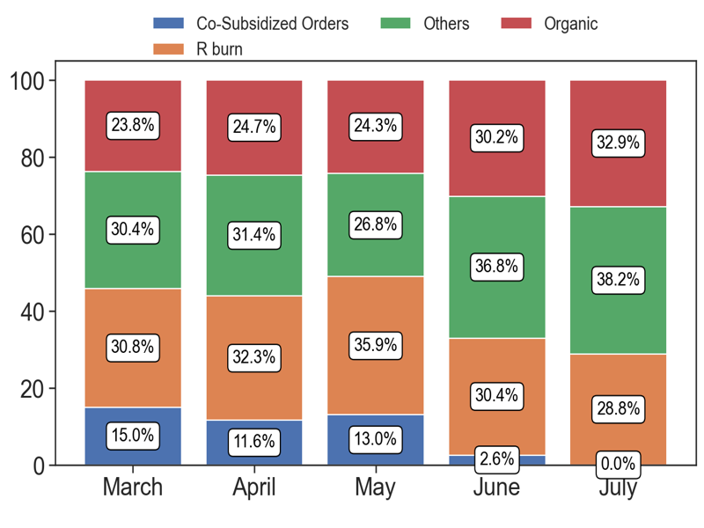
SERVICE
Action Title
Priority 5 -
Insights
Example text
Example text
Example text

Slide 16
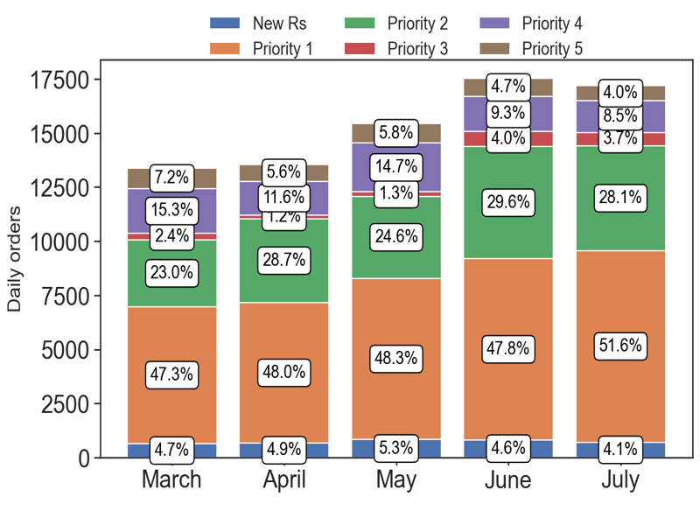
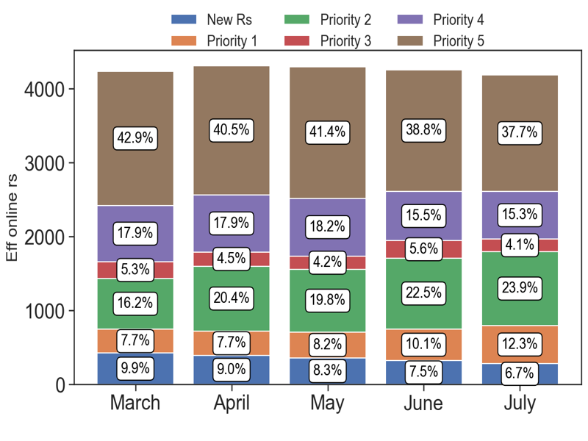
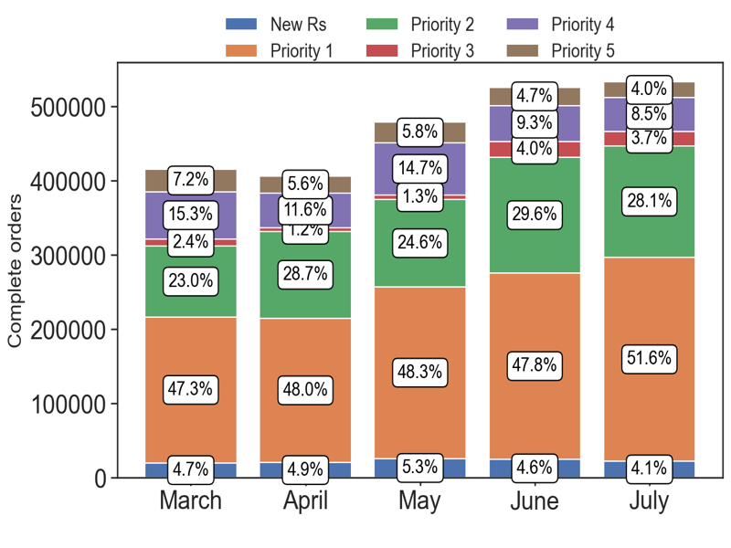
PERFORMANCE
Action Title
Country overview -
Insights
Example text
Example text
Example text

Slide 17

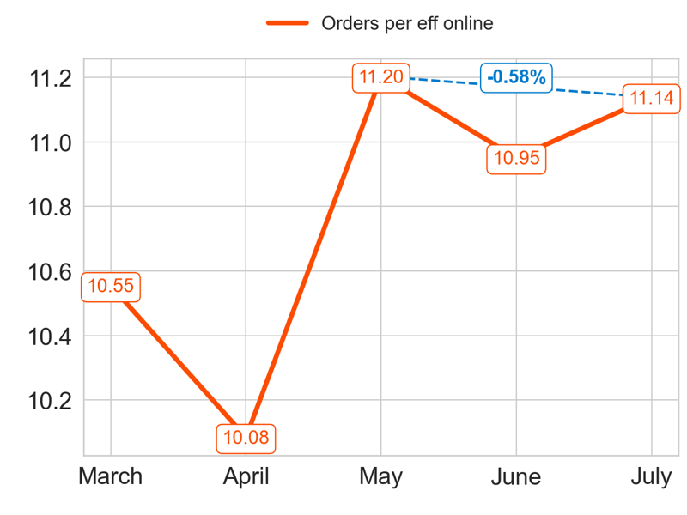
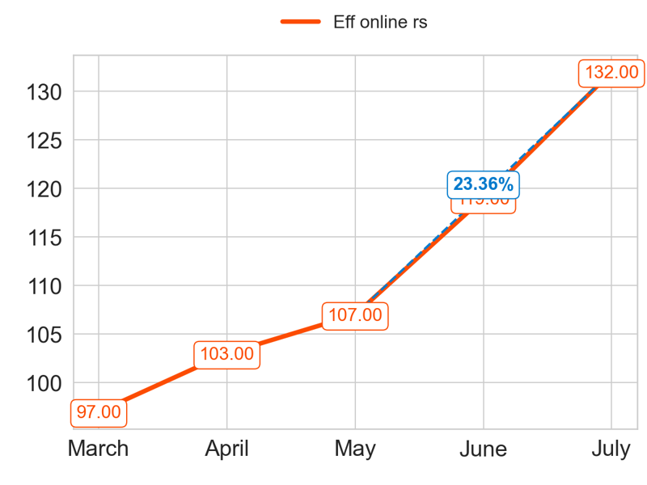

PERFORMANCE
Action Title
Priority 1 -
Insights
Mean over the last 4 months: 10.84
Mean over the last 4 months: 115.25
Mean over the last 4 months: 1258.28

Slide 18



MIXED
Action Title
Priority 1 -
Insights
Example text
Example text
Example text

Slide 19



SERVICE
Action Title
Priority 1 -
Insights
Example text
Example text
Example text

Slide 20



PERFORMANCE
Action Title
Priority 2 -
Insights
Mean over the last 4 months: 2.24
Mean over the last 4 months: 263.0
Mean over the last 4 months: 585.52

Slide 21



MIXED
Action Title
Priority 2 -
Insights
Example text
Example text
Example text

Slide 22



SERVICE
Action Title
Priority 2 -
Insights
Example text
Example text
Example text

Slide 23



PERFORMANCE
Action Title
Priority 3 -
Insights
Mean over the last 4 months: 0.76
Mean over the last 4 months: 86.25
Mean over the last 4 months: 65.3

Slide 24



MIXED
Action Title
Priority 3 -
Insights
Example text
Example text
Example text

Slide 25



SERVICE
Action Title
Priority 3 -
Insights
Example text
Example text
Example text

Slide 26



PERFORMANCE
Action Title
Priority 4 -
Insights
Mean over the last 4 months: 1.52
Mean over the last 4 months: 97.25
Mean over the last 4 months: 146.52

Slide 27



MIXED
Action Title
Priority 4 -
Insights
Example text
Example text
Example text

Slide 28



SERVICE
Action Title
Priority 4 -
Insights
Example text
Example text
Example text

Slide 29



PERFORMANCE
Action Title
Priority 5 -
Insights
Mean over the last 4 months: 0.32
Mean over the last 4 months: 697.25
Mean over the last 4 months: 221.01

Slide 30



MIXED
Action Title
Priority 5 -
Insights
Example text
Example text
Example text

Slide 31



SERVICE
Action Title
Priority 5 -
Insights
Example text
Example text
Example text

Slide 32



PERFORMANCE
Action Title
Country overview -
Insights
Example text
Example text
Example text

Slide 33




PERFORMANCE
Action Title
Priority 1 -
Insights
Mean over the last 4 months: 14.3
Mean over the last 4 months: 85.0
Mean over the last 4 months: 1211.36

Slide 34



MIXED
Action Title
Priority 1 -
Insights
Example text
Example text
Example text

Slide 35



SERVICE
Action Title
Priority 1 -
Insights
Example text
Example text
Example text

Slide 36



PERFORMANCE
Action Title
Priority 2 -
Insights
Mean over the last 4 months: 3.11
Mean over the last 4 months: 165.25
Mean over the last 4 months: 515.13

Slide 37



MIXED
Action Title
Priority 2 -
Insights
Example text
Example text
Example text

Slide 38



SERVICE
Action Title
Priority 2 -
Insights
Example text
Example text
Example text

Slide 39



PERFORMANCE
Action Title
Priority 3 -
Insights
Mean over the last 4 months: 0.81
Mean over the last 4 months: 105.25
Mean over the last 4 months: 64.88

Slide 40



MIXED
Action Title
Priority 3 -
Insights
Example text
Example text
Example text

Slide 41



SERVICE
Action Title
Priority 3 -
Insights
Example text
Example text
Example text

Slide 42



PERFORMANCE
Action Title
Priority 4 -
Insights
Mean over the last 4 months: 1.69
Mean over the last 4 months: 136.5
Mean over the last 4 months: 235.02

Slide 43



MIXED
Action Title
Priority 4 -
Insights
Example text
Example text
Example text

Slide 44



SERVICE
Action Title
Priority 4 -
Insights
Example text
Example text
Example text

Slide 45



PERFORMANCE
Action Title
Priority 5 -
Insights
Mean over the last 4 months: 0.35
Mean over the last 4 months: 436.25
Mean over the last 4 months: 154.49

Slide 46



MIXED
Action Title
Priority 5 -
Insights
Example text
Example text
Example text

Slide 47



SERVICE
Action Title
Priority 5 -
Insights
Example text
Example text
Example text

Slide 48



PERFORMANCE
Action Title
Country overview -
Insights
Example text
Example text
Example text

